Slide 1
Java Fundamentals
Exception Handling in Java

Slide 2
Exception
An exception is an unwanted or unexpected event, which occurs during the execution of a program i.e. at run time, that disrupts the normal flow of the program’s instructions.
Error vs Exception
Error: An Error indicates serious problem that a reasonable application should not try to catch. Exception: Exception indicates conditions that a reasonable application might try to catch.

Slide 3
Exception
A Java Exception is an object that describes the exception that occurs in a program. When an exceptional events occurs in java, an exception is said to be thrown. The code that's responsible for doing something about the exception is called an exception handler.

Slide 4
Exception Handling
The Exception Handling in Java is one of the powerful mechanism to handle the runtime errors so that normal flow of the application can be maintained.
Advantage of Exception Handling
The core advantage of exception handling is to maintain the normal flow of the application. An exception normally disrupts the normal flow of the application that is why exception handling is used.

Slide 5
statement 1;
statement 2;
statement 3;
statement 4;
statement 5;//exception occurs
statement 6;
statement 7;
statement 8;
statement 9;
statement 10;
Suppose there are 10 statements in your program and there occurs an exception at statement 5, the rest of the code will not be executed i.e. statement 6 to 10 will not be executed. If we perform exception handling, the rest of the statement will be executed. That is why we use exception handling in Java.

Slide 6
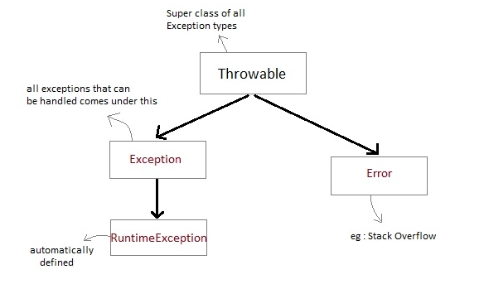
Exception class Hierarchy
All exception types are subclasses of class Throwable, which is at the top of exception class hierarchy.

Slide 7
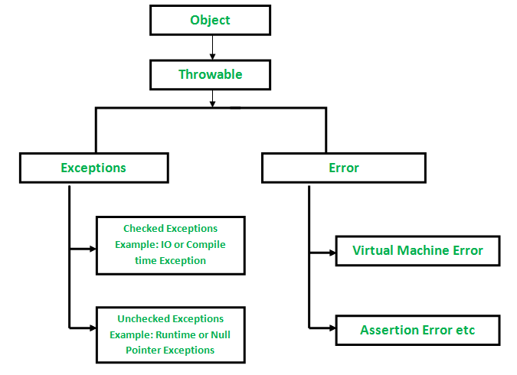

Slide 8
Exception are categorized into 3 category
1. Checked Exception
The exception that can be predicted by the programmer at the compile time.
Example: File that need to be opened is not found. These type of exceptions must be checked at compile time.
2. Unchecked Exception
Unchecked exceptions are the class that extends RuntimeException. Unchecked exception are ignored at compile time.
Example : ArithmeticException, NullPointerException, Array Index out of Bound exception. Unchecked exceptions are checked at runtime.
3. Error
Errors are typically ignored in code because you can rarely do anything about an error.
Example :if stack overflow occurs, an error will arise. This type of error cannot be handled in the code.

Slide 9
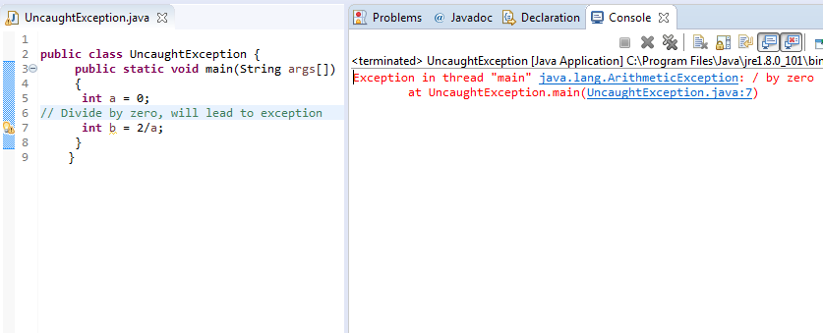
Uncaught Exceptions
This will lead to an exception at runtime, hence the Java run-time system will construct an exception and then throw it. As we don't have any mechanism for handling exception in the above program, hence the default handler will handle the exception and will print the details of the exception on the terminal.

Slide 10
Exception Handling Mechanism
In java, exception handling is done using five keywords,
try
catch
throw
throws
finally
Exception handling is done by transferring the execution of a program to an appropriate exception handler when exception occurs.

Slide 11
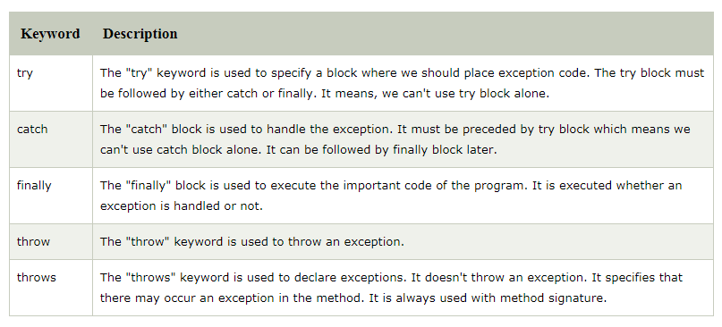

Slide 12
Using try and catch
Try is used to guard a block of code in which exception may occur. This block of code is called guarded region.
A catch statement involves declaring the type of exception you are trying to catch.
If an exception occurs in guarded code, the catch block that follows the try is checked, if the type of exception that occurred is listed in the catch block then the exception is handed over to the catch block which then handles it.

Slide 13
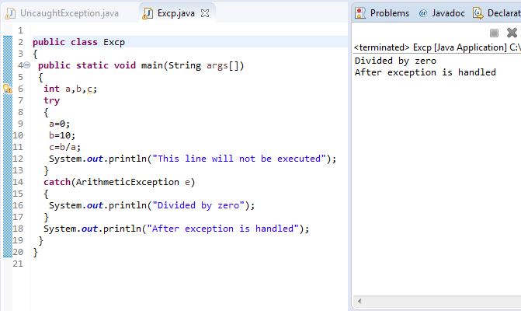

Slide 14
An exception will thrown by this program as we are trying to divide a number by zero inside try block.
The program control is transferred outside try block.
Thus the line "This line will not be executed" is never parsed by the compiler.
The exception thrown is handled in catch block.
Once the exception is handled, the program control is continue with the next line in the program i.e. after catch block.
Thus the line "After exception is handled" is printed.

Slide 15
Multiple catch blocks
A try block can be followed by multiple catch blocks.
You can have any number of catch blocks after a single try block.
If an exception occurs in the guarded code the exception is passed to the first catch block in the list.
If the exception type of exception, matches with the first catch block it gets caught, if not the exception is passed down to the next catch block.
This continue until the exception is caught or falls through all catches.

Slide 16
Nested try statement
try statement can be nested inside another block of try.
Nested try block is used when a part of a block may cause one error while entire block may cause another error.
In case if inner try block does not have a catch handler for a particular exception then the outer try catch block is checked for match.

Slide 17
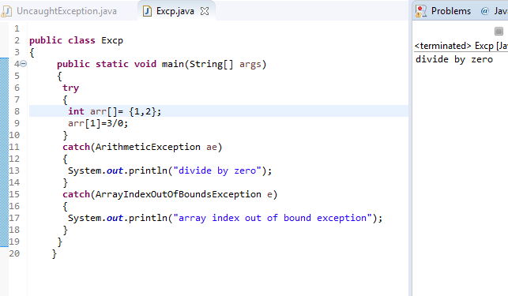
Although both ArrayIndexOutOfBoundsException and ArithmeticException occured, but since first catch is of Arithmetic Exception, It will be caught there and program control will be continued after the catch block.
At a time, only one exception is processed and only one respective catch block is executed.

Slide 18
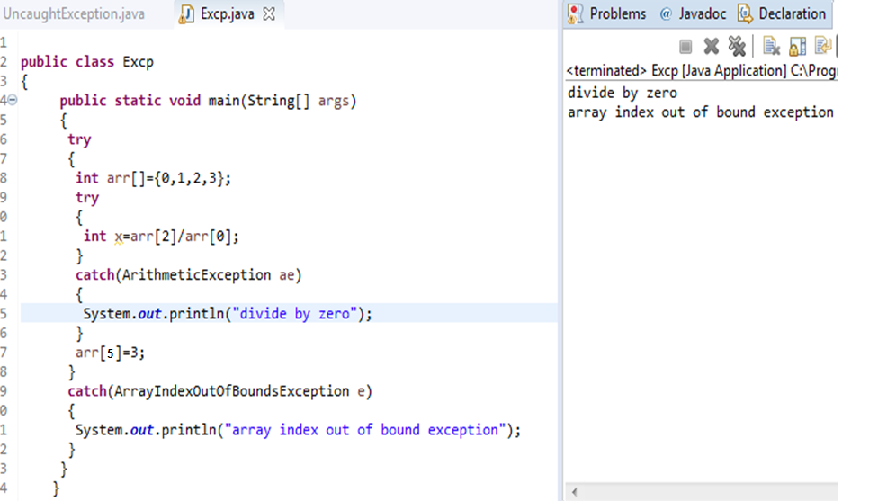

Slide 19
throw Keyword
throw keyword is used to throw an exception explicitly.
Only object of Throwable class or its sub classes can be thrown.
Program execution stops on encountering throw statement, and the closest catch statement is checked for matching type of exception.
Syntax :
throw ThrowableInstance

Slide 20
Creating Instance of Throwable class
There are two possible ways to create an instance of class Throwable,
Using a parameter in catch block.
Creating instance with new operator. new NullPointerException("test");This constructs an instance of NullPointerException with name test.

Slide 21
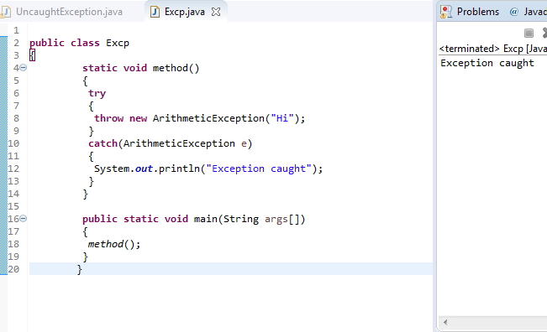
In this example the method throw an instance of ArithmeticException, which is successfully handled using the catch statement and thus, the program outputs "Exception caught".

Slide 22
throws Keyword
Any method that is capable of causing exceptions must list all the exceptions possible during its execution, so that anyone calling that method gets a prior knowledge about which exceptions are to be handled. A method can do so by using the throws keyword.
Syntax :
type method_name(parameter_list) throws exception_list
{
//definition of method
}

Slide 23
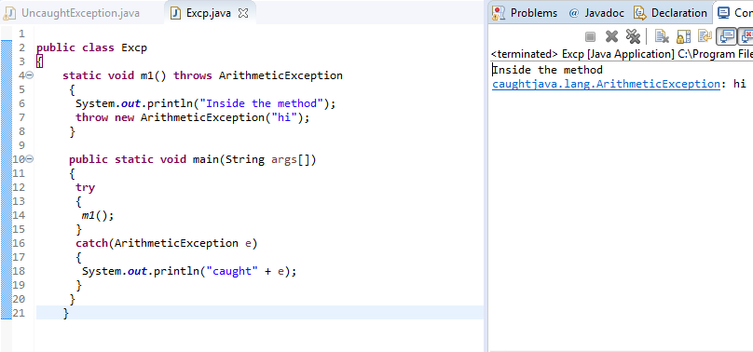

Slide 24
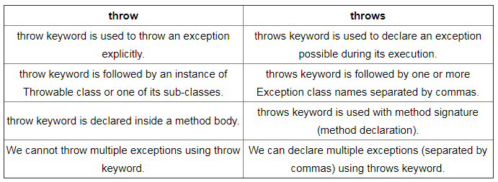
Difference

Slide 25
finally clause
A finally keyword is used to create a block of code that follows a try block.
A finally block of code is always executed whether an exception has occurred or not.
Using a finally block, it lets you run any cleanup type statements that you want to execute, no matter what happens in the protected code.
A finally block appears at the end of catch block.

Slide 26
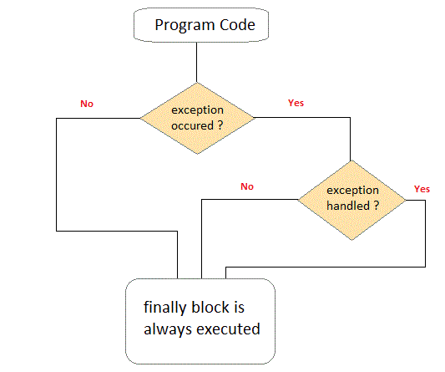

Slide 27
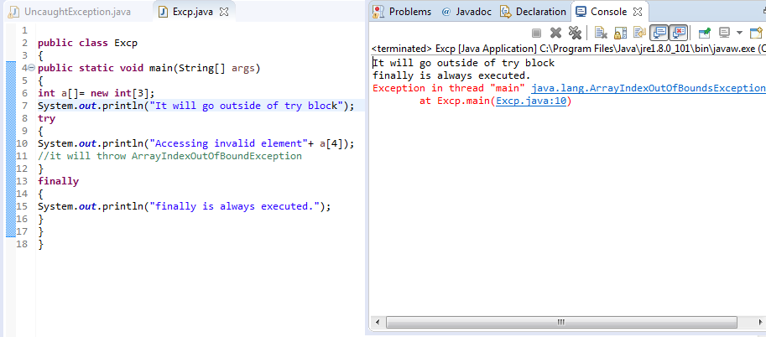
Thus even if exception is thrown by the program, which is not handled by catch block, still finally block will get executed.

Slide 28
User defined Exception subclass
Create own exception sub class simply by extending java Exception class.
Define a constructor for Exception sub class (not compulsory) and you can override the toString() function to display customized message on catch.

Slide 29
